Slide 1
Simulations

Slide 2
Since Last meeting
Compare simulation results and codes with Diego
Now the same results for both OOK and 16-QAM in single polarization
Interleaving OOK and 16-QAM channels
Uniform OOK channels are fixed
Insert 16-QAM channels inbetween
What is the feasible region of power and baudrate for 16-QAM?

Slide 3
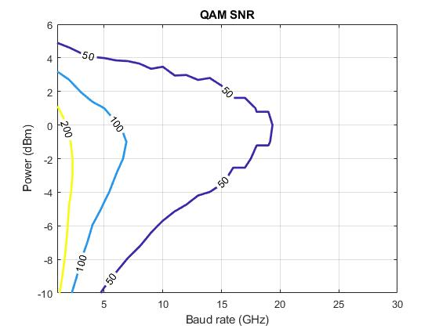
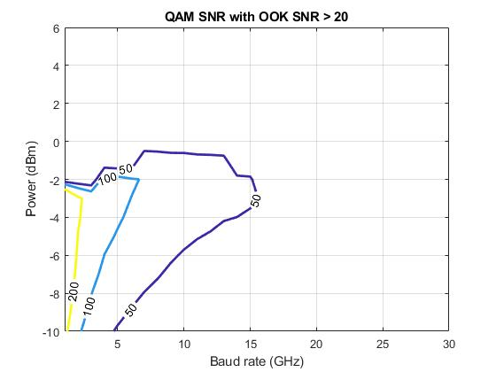
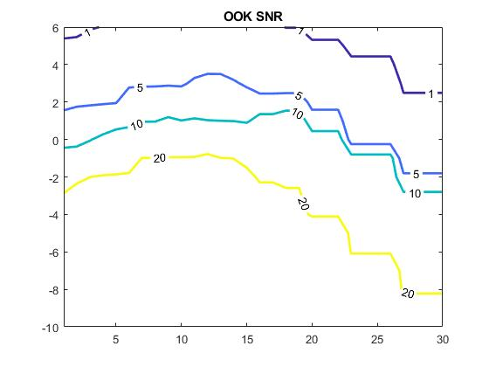
Ongoing Simulation – 2 OOK Channels

Slide 4
Next Step
Consolidate simulation code
Correct previous simulations
Continue interleaving simulations

